Slide 1

MACHINE LEARNING-BASED WHEAT YIELD PREDICTION WITH OPTIMIZATION FOR ACCURATE FORECASTING

Slide 2
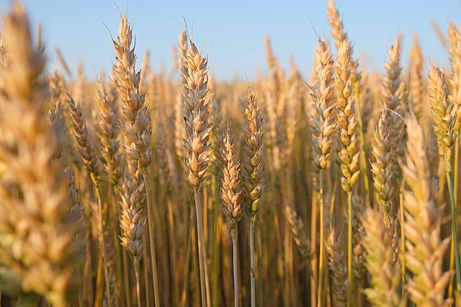

content
ABSTRACT
PROBLEM DEFINITION
OBJECTIVE & SCOPE
LITERATURE SURVEY
SYSTEM ARCHITECTURE
ALGORITHMS

Slide 3

ABstract
Wheat yield prediction is essential for food security and helps in resource planning and risk management.
Traditional methods lack precision and fail to consider complex environmental factors affecting crop growth.
Deep learning algorithms analyze large datasets to identify patterns missed by traditional approaches.
A mobile application will provide farmers with easy access to yield forecasts and decision-support tools.

Slide 4
CONT..
Real-time environmental data integration ensures rimely and more accurate yield predictions.
Cloud deployment will enable scalability, remote access, and efficient data management.
The proposed system offers improved accuracy and adaptability to changing environmental conditions.
Enhanced predictions will help farmers make informed decisions and promote sustainable wheat production.

Slide 5

PROBLEM DEFINITION
Existing wheat yield prediction methods rely on traditional statistical models and expert insights.
These approaches depend on static data sources, limiting prediction accuracy.
Traditional models cannot adapt to dynamic environmental changes and evolving conditions.

Slide 6

Farmers face challenges in making timely and informed decisions due to outdated methodologies.
There is a lack of multi-source data integration, reducing the comprehensiveness of predictions.
Advanced analytical techniques are not fully utilized to capture complex agricultural patterns.

Slide 7

Inaccurate predictions result in inefficient resource allocation and potential yield losses.
An intelligent, adaptive system is needed to provide precise and timely wheat yield forecasts.

Slide 8
objective
Scope

Slide 9

Develop a machine learning-based wheat yield prediction model by integrating climate forecasts and soil moisture data to improve accuracy.
Apply deep learning techniques to analyze large-scale agricultural datasets, uncovering hidden patterns and improving prediction precision.

Slide 10
Design a user-friendly mobile application to provide farmers with easy access to yield forecasts and decision-support tools.
Implement a cloud-based database system for efficient data storage, scalability, accessibility, and real-time processing.

Slide 11
Wheat Yield Prediction Using Remote Sensing and Machine Learning
Merit:
High Accuracy: Combining remote sensing data with machine learning models allows for more precise and timely wheat yield predictions by integrating various environmental factors.
Limitation:
Data Dependency: The quality and availability of remote sensing data, such as satellite imagery, can be affected by weather conditions (e.g., cloud cover) and limited resolution, which may impact prediction accuracy.
LITERATURE
SURVEY

Slide 12
Deep Learning Models for Wheat Yield Prediction Using Meteorological Data
Merit:
Ability to Capture Complex Patterns: Deep learning models can effectively capture non-linear relationships and intricate patterns in meteorological data, leading to highly accurate yield predictions.
Limitation:
Data and Computational Intensive: Deep learning models require large amounts of high-quality data for training and significant computational resources, which may not always be available in agricultural settings.
LITERATURE
SURVEY

Slide 13
Wheat Yield Prediction Using Crop Simulation Models and Weather Data
Merit:
Accurate Predictions: Combines weather data with crop models for detailed and accurate yield forecasts.
Limitation:
Data Intensive: Requires detailed input data, which can be hard to obtain in some regions.
LITERATURE
SURVEY

Slide 14
Hybrid Model for Wheat Yield Prediction Using Soil Moisture and Climate Data
Merit:
Improved Accuracy: Combines soil moisture and climate data, offering more reliable and context-aware yield predictions.
Limitation:
Data Integration Challenges: Combining diverse data sources can be complex and may require significant preprocessing and synchronization.
LITERATURE
SURVEY

Slide 15
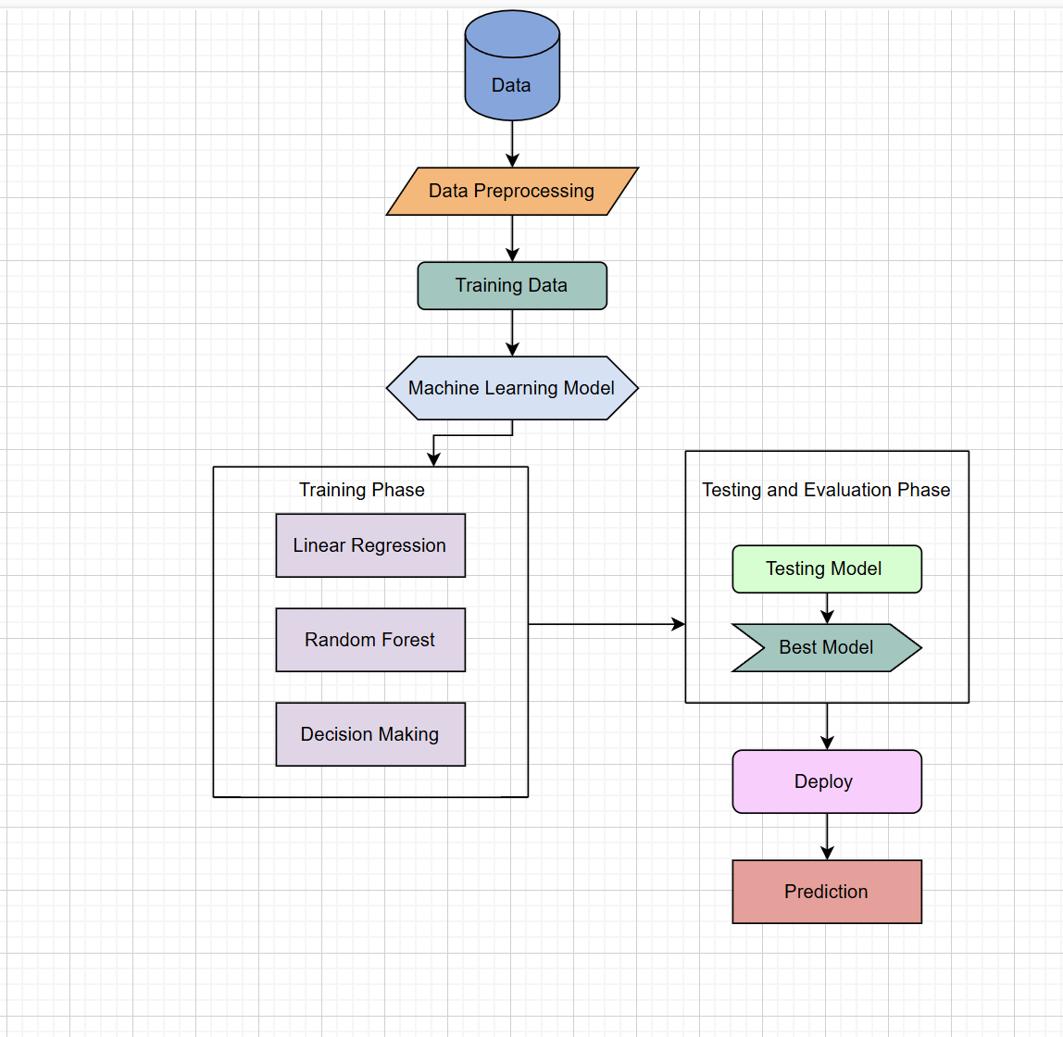

SYSTEM
ARCHITECTURE

Slide 16
ALGORITHMS
Linear Regression
Use Case: If the relationship between the input features (like soil moisture, temperature, rainfall) and yield is approximately linear.
Pros: Simple to implement, interpretable, and efficient for smaller datasets.
Cons: May not capture complex, non-linear relationships.

Slide 17
Random Forest
Use Case: An ensemble method that builds multiple decision trees to improve prediction accuracy.
Pros: Robust to overfitting, handles large datasets well, and provides feature importance.
Cons: Can be computationally expensive and less interpretable than a single decision tree.

Slide 18
Decision Trees
Use Case: Useful for capturing non-linear relationships between features.
Pros: Easy to interpret, can handle both numerical and categorical data, and is good for understanding feature importance.
Cons: Can overfit if not pruned properly.

Slide 19
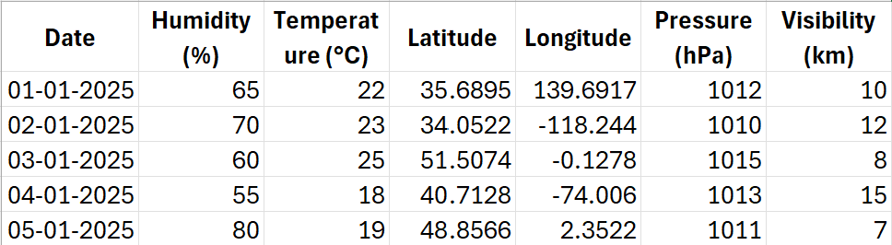
SAMPLE DATA

Slide 20
THANK YOU!

